Slide 1
Simmering Data
Using Beautiful Soup and Python to Scrape Data from Web Pages
Joe Matise, NORC IT, Data Services

Slide 2

Agenda
01 | SAS, Python, and Web Scraping
02 | Making a Beautiful Soup
03 | Reading the Recipe
04 | Gathering the Ingredients
05 | Stirring the Soup
06 | Tasting the Results

Slide 3
SAS, Python, and Web Scraping

Slide 4
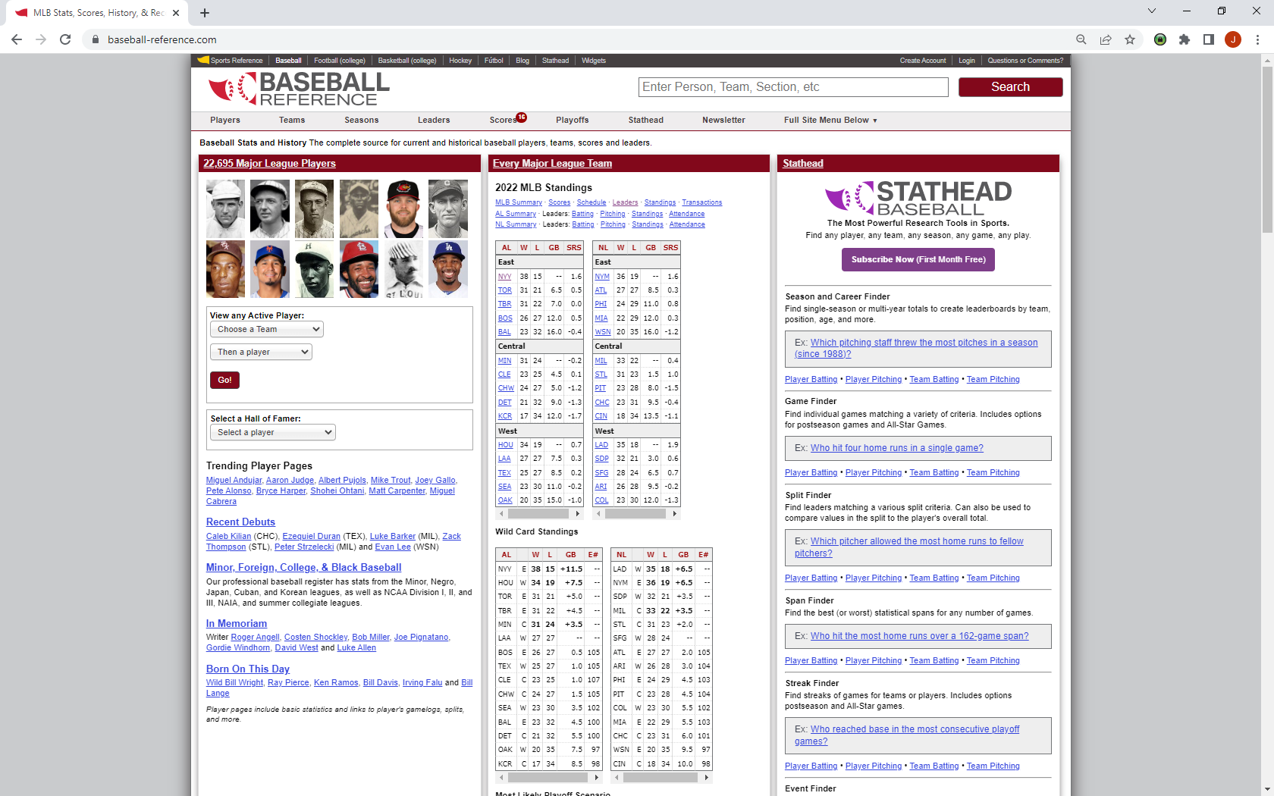
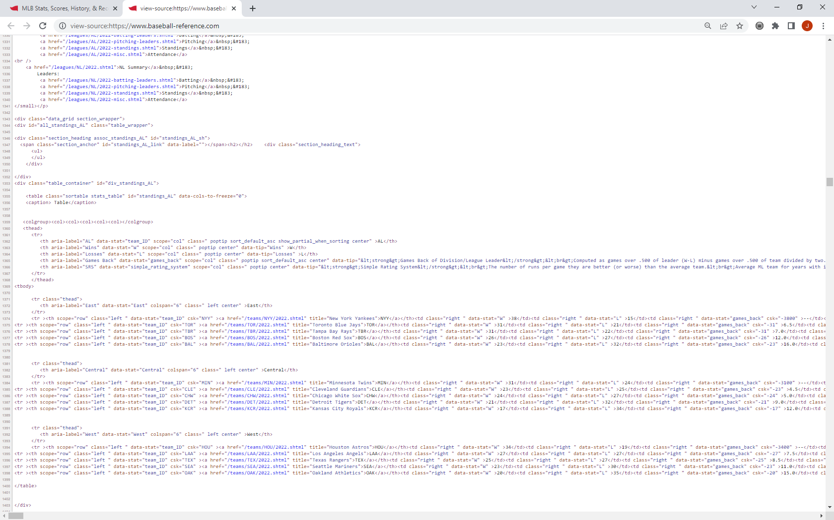
Introduction: SAS, Python, and Web scraping
Web Scraping: What Is It?
Reading Data from Web Pages
HTML: the language of the Web
Not all pages are written in HTML – but nearly all end up there!
JavaScript, CSS, and Server-Side code
What You See vs. What Your Browser Sees
Over 4500 lines of code!

Slide 5
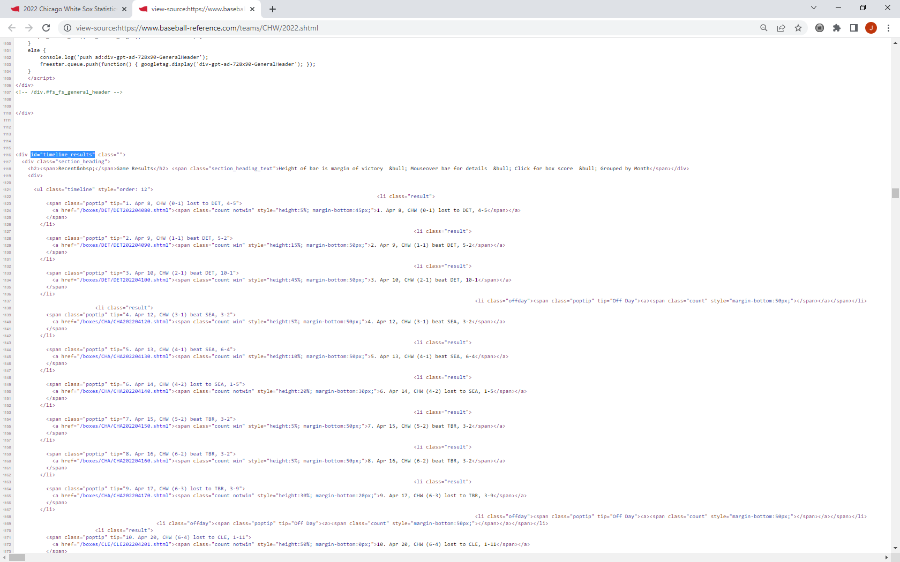
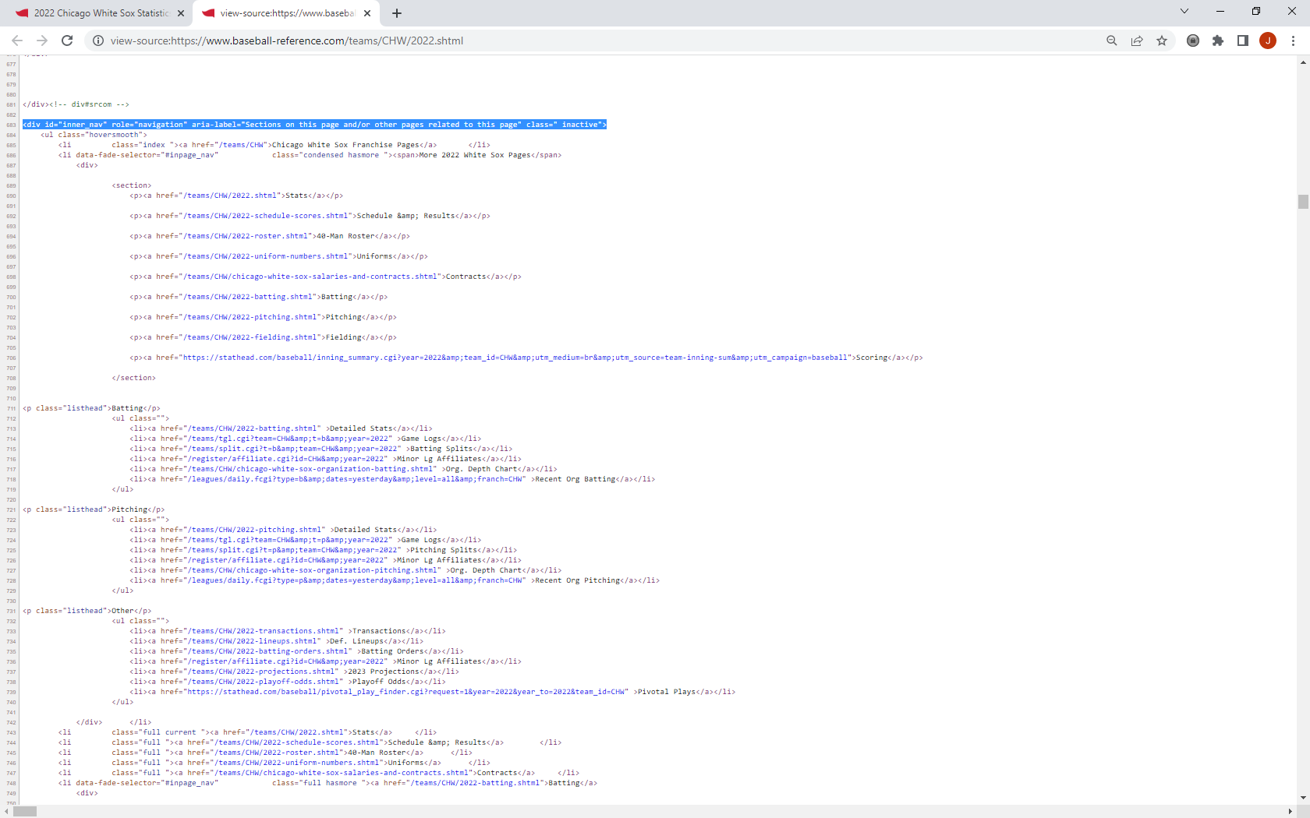
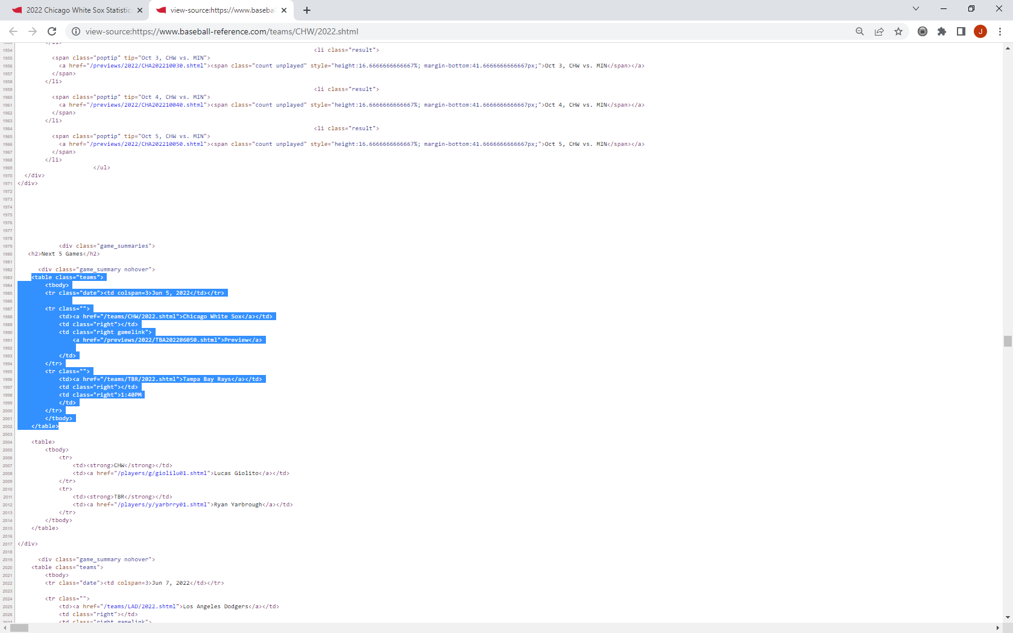
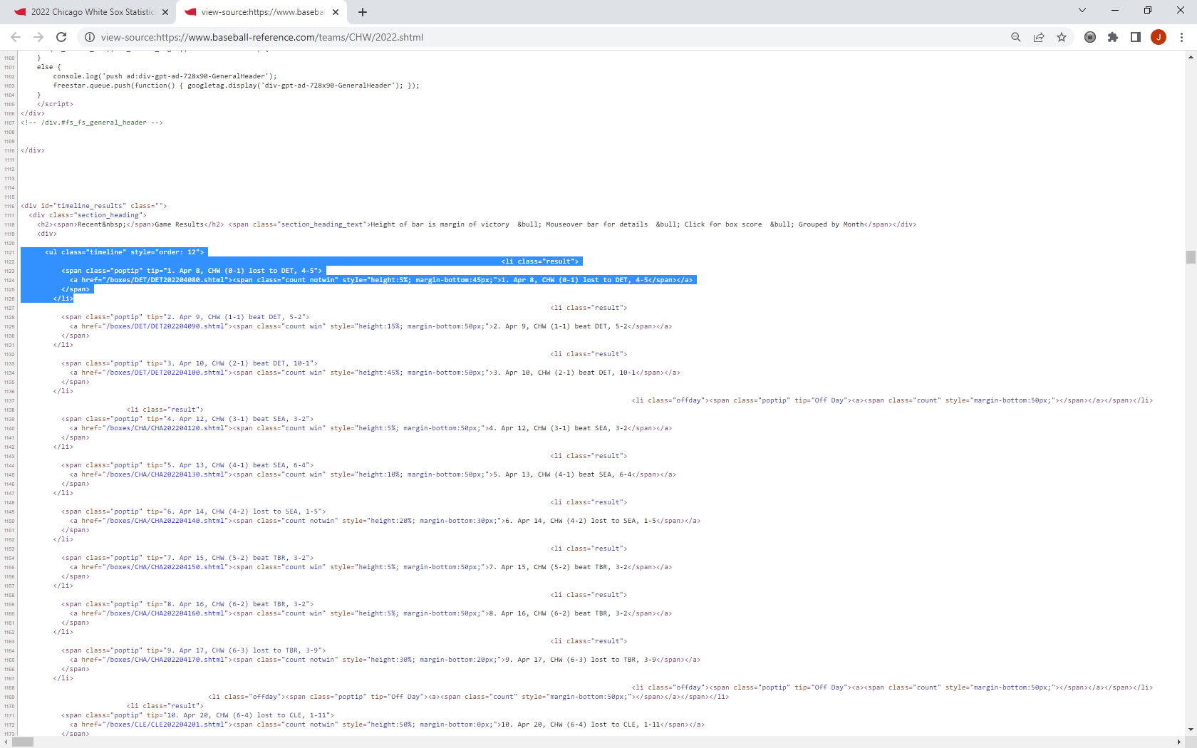
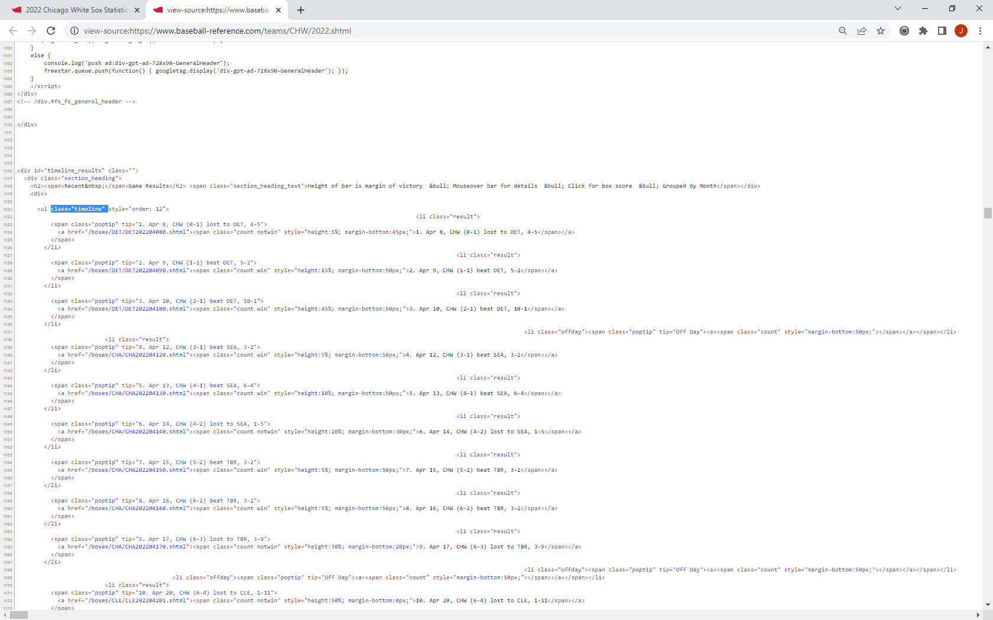
Introduction: SAS, Python, and Web scraping
Key Elements
Structures:
Div
Table
List
Selectors:
ID
Class

Slide 6
Introduction: SAS, Python, and Web scraping
Web Scraping: SAS vs Python
SAS
Read via Data Step
PROC HTTP for complex page interactions
XML Libname Engine?
Perl Regular Expressions
Python
Many libraries exist in Python 3
Two parts: get data and parse data
Get data: urllib, Requests
Parse data: BeautifulSoup
Even more advanced: Scrapy, PySpider
Selenium – Headless Browsing

Slide 7
Making a Beautiful Soup

Slide 8
Working an example: Beautiful Soup
Beautiful Soup
Beautiful Soup 4.11
What it does: Reads text formatted as HTML, parses out pieces
What it does not do: directly access a website (urllib, Requests, etc. do this)
Documentation: https://www.crummy.com/software/BeautifulSoup/bs4/doc/
General Strategy
Identify container that contains your data
Identify the level that contains your data
Navigate Parent->Child relationships
Copy the results of the BeautifulSoup objects to your preferred data type (List, DataFrame, etc.)

Slide 9
Working an example: Beautiful Soup
Getting Started
Import your libraries
import urllib
from urllib.request import urlopen
from bs4 import BeautifulSoup
Read your HTML document, and pass it to BeautifulSoup
response = urlopen('url')
html_doc = response.read()
soup = BeautifulSoup(html_doc, 'html.parser’)
Now, it is ready to work with!

Slide 10
Reading the Recipe

Slide 11
Reading the Recipe: Beautiful Soup
Tag object
Tags correspond to HTML tags, and are named identically
Use dot notation – soup.table will refer to a <table> tag
Tags have attributes. Some important ones:
ID: the ID for a tag uniquely (hopefully) identifies that one tag
Class: this is used to apply formatting to similar tags – but is also helpful for us!
Refer to the attributes using ['attribute'] notation
if soup.table['id'] = 'myDataTable’ …
Tags can be nested
soup.table.tr.td …

Slide 12
Reading the Recipe: Beautiful Soup
Key concepts
The “Family” Tree
A tag has a list, tag.contents[], containing all the tags inside it, and a tag.children generator
A tag also has a single parent, tag.parent, and a list of all parents, tag.parents
Tags also have siblings, using .next_sibling and .previous_sibling
Tag contents
.text method gives the simplest result – just the text
.string method and .strings generator gives NavigableStrings (parents/children)
.get_text() method returns all text inside a tag, and has some useful options

Slide 13
Reading the Recipe: Beautiful Soup
Finding your way around
Using .find_all()
find_all() creates a list of all matching descendants of the current tag based on the filters passed to it
Valid filters:
name - the kind of tag you want to search for
attrs – attributes like id, class, etc. that identify the tag
string – filter by a string (plain text)
Iterate over the list to identify what you need (or grab it)
Using .find()
Use .find() to find just one tag
Mostly used for singleton tags or tags where you know the id
Using selectors
If you know CSS selectors, this can be very powerful
.select(“your_css_selector”) selects a list of tags based on the css selector provided

Slide 14
Gathering the Ingredients

Slide 15
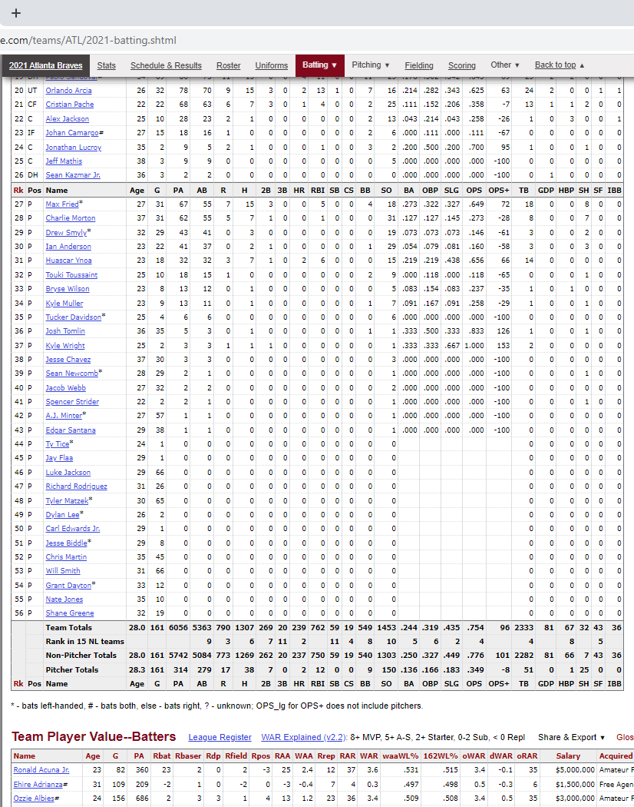
Gathering the Ingredients: Problem Statement
Problem:
Using BaseballReference, identify the World Series-winning team with the lowest OPS+ (On Base Percentage Plus Slugging, adjusted for league average and ballpark) in the regular season, since 1908.

Slide 16
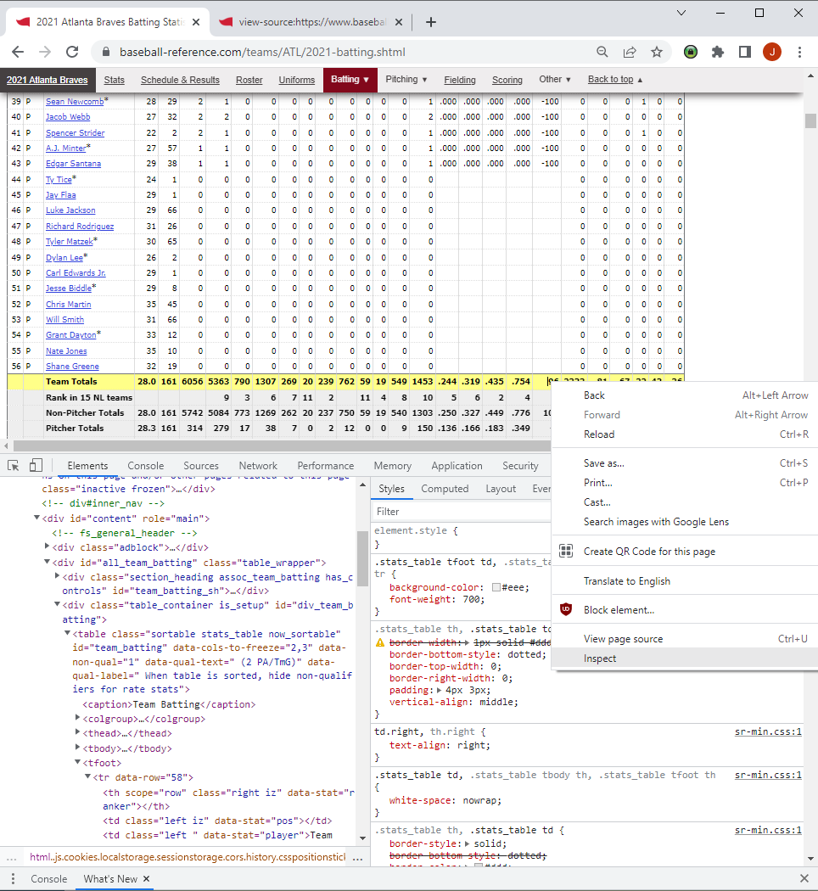




Gathering the Ingredients: RaW INGREDIENTS
Our ingredients are in the HTML…
<table>
id=“team_batting”
<tfoot>
<tr>
data-row=“58”
<td>
data-stat= “onbase_plus_slugging_plus”

Slide 17
Stirring the Soup

Slide 18
Stirring the Soup: Overview
Steps to solving the problem
Write a function to parse a single team page
Write a function to parse a page that has the list of teams and call the first function once for each, and save the relevant information in a list (of dictionaries) or a Pandas DataFrame
Call the list function, and determine the lowest OPS+ value from that list

Slide 19



Stirring the Soup: Parsing a single page
1. Parsing a single page
def ops_tot(team_str):
response = urlopen('https://www.baseball-reference.com' + team_str)
html_doc = response.read()
soup = BeautifulSoup(html_doc, 'html.parser')
table = soup.find('table',id='team_batting')
if table != None:
for tfoot in table.tfoot:
td = tfoot.find_all('td')
for t in td:
if t['data-stat'] == 'onbase_plus_slugging_plus' and t.text != '':
return(t.text)

Slide 20
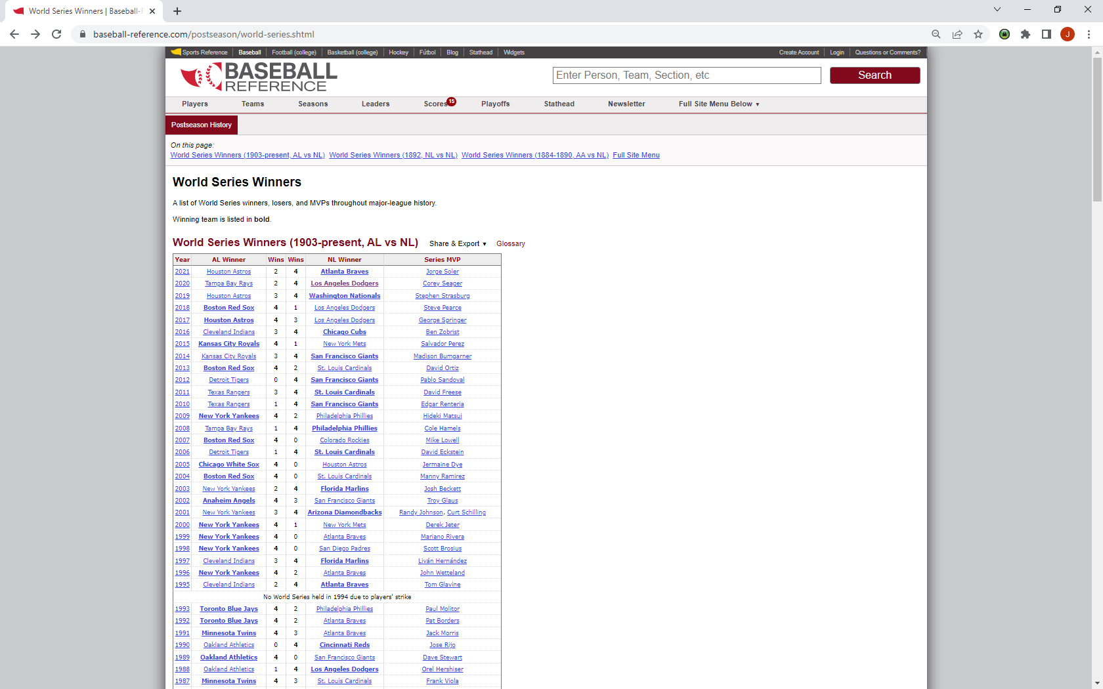
Stirring the Soup: Parsing THE LIST OF TEAMS

Slide 21
Stirring the Soup: Parsing THE LIST OF TEAMS
2. Parsing the list of teams
def ws_winners():
response = urlopen('https://www.baseball-reference.com/postseason/world-series.shtml')
html_doc = response.read()
soup = BeautifulSoup(html_doc, 'html.parser')
stats = [] #initialize the list to store our stats in
table = soup.find('table',id='world_series_winners_al_nl')
if table != None:
for row in table.find_all('tr'):
ws_stats = {} #initialize our dictionary
if row.contents[0].name == 'th': #Look for th at the start (eliminates non-data rows)
year = row.contents[0].text #grab the year
strong_cells = row.find_all('strong')#look for cells with <strong> tag. WS winner is bolded!
for cell in strong_cells:
try: #need try-except because of bolded Wins
link = cell.find('a')['href']#find the value of the href attribute in the anchor tag>
ws_stats['team'] = cell.text #the team name
ws_stats['ops+'] = int(ops_tot(link)) #call the earlier function to read the OPS+
ws_stats['year'] = year #save the year
stats.append(ws_stats) #append to the main list
print(ws_stats)
except(TypeError):
pass
return(stats) #return the value

Slide 22
Stirring the Soup: Finding the minimum
3. Finding the minimum
final_stats = ws_winners()
minOPS = min(final_stats,key=lambda x:x['ops+'])
print(minOPS)

Slide 23
Tasting the Results

Slide 24
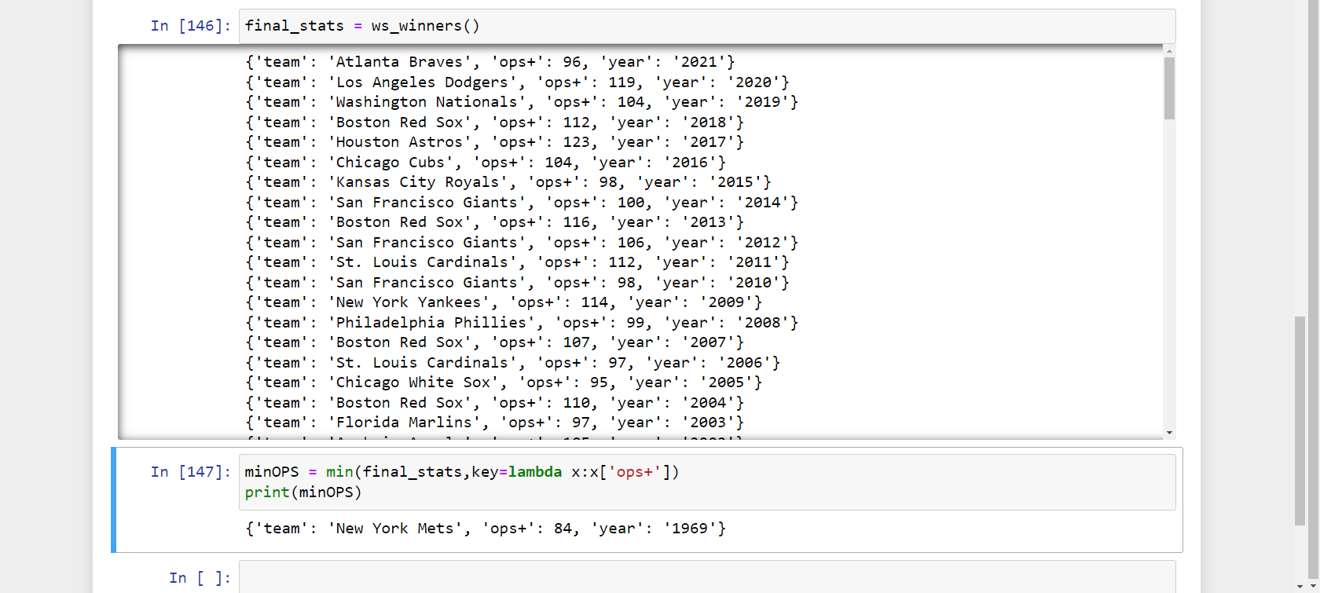
Tasting the Results
And the winner (??) is…

Slide 25
Questions?

Slide 26
Thank you.
Find code and slides at: https://github.com/snoopy369/presentations “Simmering Data with Beautiful Soup and Python”
Joe Matise
Supervisor, IT Data Services
matise-joe@norc.org

